Slide 1
Reading and Phonics Workshop

Slide 2
It starts with speaking and listening. What can you do…
Talk to them!
Model and expect good listening
Encourage the understanding and use of new vocabulary
Sing songs, rhymes and poems, enjoying the rhyme and rhythm of words
Read to your child regularly and develop their story language
Play games – I Spy, Alliteration is a lot of fun to play around with. Your child’s name can be a good place to start. For example, say ‘Connie caught a cat’, ‘Jolly Jessica Jumped’ or ‘Mason Munches Muffins’

Slide 3
Reading at School
Shared Reading
Reading practice
Phonics

Slide 4
Reading at Home – What will you get from school
E-Books
Home learning tasks will be set on
Evidence me
Library book
Reading for pleasure book

Slide 5
Reading at Home
Quiet place for reading
Let them see you reading
Follow your child's lead
Enjoyable shared experience!

Slide 6
Maintain the flow for understanding and enjoyment
If your child mispronounces a word do not interrupt immediately, instead allow opportunity for self correction
If your child does try to ‘sound out’ words, encourage the use of letter sounds rather than ‘alphabet names’
Which leads us onto phonics…

Slide 7
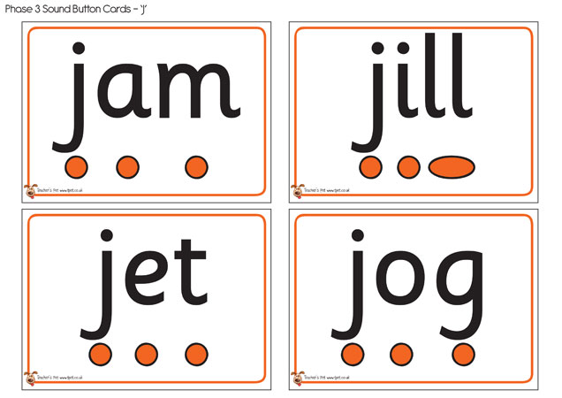
New Vocabulary!
Phonics – the learning of letters and sounds
Phoneme – the sound a letter makes
Grapheme – the written letter
Blending – running sounds together to make a word
Segmenting – breaking a word up into its component sounds
Tricky Words – Words that cannot be decoded using phonics
CVC – c = consonant v = vowel
Digraph – a sound made with two letters eg sh ai oi

Slide 8
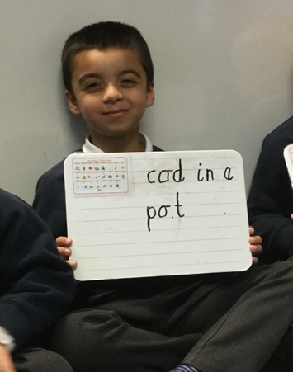
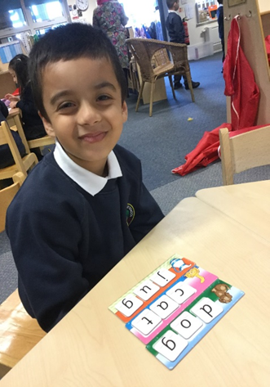
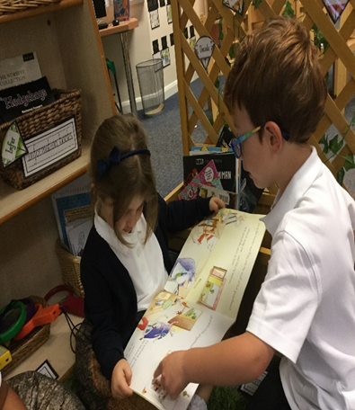
Phonics at Pinders
Structured programme – Little Wandle
Fast pace, lots of consolidation

Slide 9
Phase 1
All about sounds, musical, environmental, voice and body
Can they hear sounds?
Begin to blend and segment orally

Slide 10
Phase 2

Slide 11
Phase 3

Slide 12
Phase 4

Slide 13
Expectations – Home / School
We ask parents to write in the reading record every time you read together. Our expectation is for each child to read 5 times per week.

Slide 14
Thank you…..
Your support is very much appreciated and makes all the difference to your child's progress

