Slide 1
Reading Workshop

Slide 2
Development within Reading
Reading is a crucial skill that people require throughout their entire life. We use our reading skills daily and without these, life would be much more challenging.
In EYFS, the children learn the foundations for all the key components within reading. These include:
Holding a book upright and turning the pages correctly
Understanding that in the English language, we read from left to right
Learning how to say sounds, recognise letter groups and read words.
Understanding what they have read and answer questions about it.

Slide 3
What does the government say about reading?
Comprehension Children at the expected level of development will: - Demonstrate understanding of what has been read to them by retelling stories and narratives using their own words and recently introduced vocabulary; - Anticipate – where appropriate – key events in stories; - Use and understand recently introduced vocabulary during discussions about stories, non-fiction, rhymes and poems and during role-play.
Word Reading Children at the expected level of development will: - Say a sound for each letter in the alphabet and at least 10 digraphs; - Read words consistent with their phonic knowledge by sound-blending; - Read aloud simple sentences and books that are consistent with their phonic knowledge, including some common exception words.
Writing Children at the expected level of development will: - Write recognisable letters, most of which are correctly formed; - Spell words by identifying sounds in them and representing the sounds with a letter or letters; - Write simple phrases and sentences that can be read by others.

Slide 4
What does reading look like in school?
Daily story sessions to promote a love of reading
Book centered curriculum
Group reading practice sessions
Individual opportunities for book sharing
Phonics sessions
Reading links throughout the provision and activities

Slide 5
How do you teach reading skills?
It is very important to understand how to teach a child to read as this will enable you to support them at home. When a child is learning to read, they are learning to use multiple skills at once.
Firstly, a child must be able to recognise a single letter and say the sound for each letter. This needs to be the letter sound as opposed to the letter name.

Slide 6
How do you teach reading skills?
The other skill that the children need to use when reading is the skill of blending.
Firstly, a child needs to tune in to sounds orally, then learn to blend them together (n...e...t...net). Once they can do this, they will move on to blending sounds that they can see written down. This could be print in books or any other print they may see.
Ask your child to tell you the sounds they can see in a simple 3 letter word e.g. cat. After they have identified c...a...t, repeat it back to them. This is you modelling to them the skill of blending. Exaggerate each sound and give your child a chance to blend independently.
If your child is struggling to blend a word independently, help them to ensure they do not become frustrated. You can then encourage them to blend the next word independently.
It is very important that your child blends after every single word that they read. This is teaching them good habits of reading and allows them to improve their fluency.

Slide 7
The next stages of reading...
Once your child can recognise single letter sounds and blend, we need to encourage fluency and comprehension. You can do this by re-reading the sentence with your child and pointing to each word as you read. You can also encourage your child to read with some expression – in school we call this prosody.

Slide 8
Comprehension
When sharing a story (whether it be a bedtime story or sharing a book from school) it is important to bring the story to life. This enables children to develop their vocabulary and imagination.
To help develop their comprehension, ask your children questions about what they have read.
To develop fluency, ask the children to reread what they have read. You could read it back to them and add in some expression too.

Slide 9
Story sharing
We would encourage you to share a bedtime story with your child daily. This is a calm time before bed which helps develop their language and listening skills.
You could read a story book, their school reading book or their reading for pleasure book.
Try to select books based on your child's interests. For example, if your child is interested in space look for a range of fiction and non-fiction books based on the topic. If you are stuggling to find books that are suitable for this age, ask a member of the team and we can give you some ideas!

Slide 10
How you can help with reading at home...
In order for your child to develop the fundamental skills required for reading, we need to expose them to as many opportunities as possible!
You could do this by:
Sharing stories at bedtime
Reading their book at least 5 times a week
Visiting the library
Expect them to use language correctly (model it back to them)
Sound talk choices to them
Cook/bake with them involving following instructions
Encourage use of puppets and characters to tell stories
Model reading with fluency and expression

Slide 11
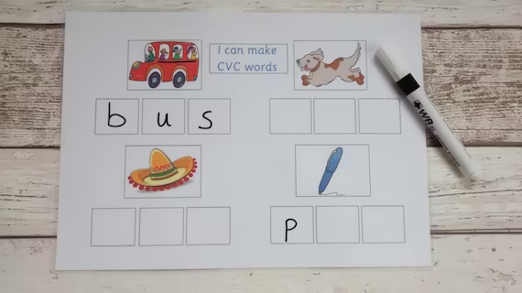
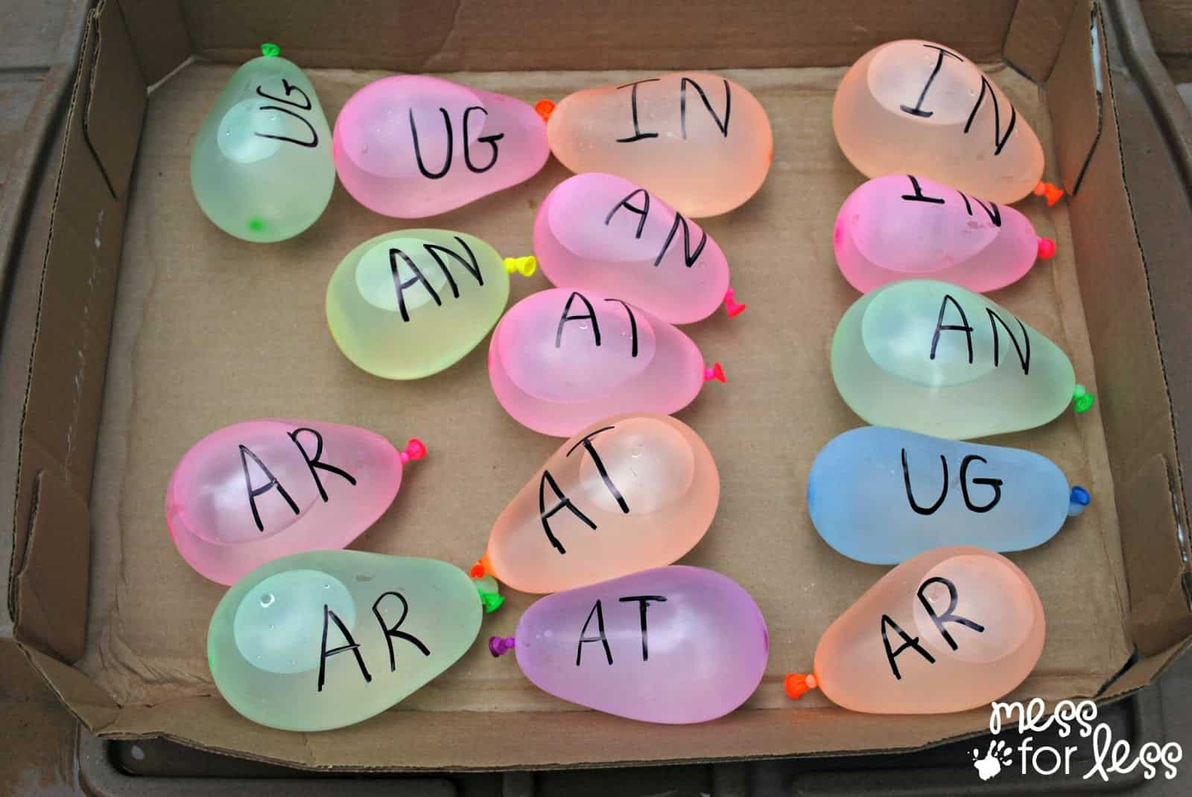
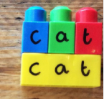
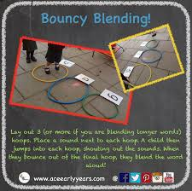
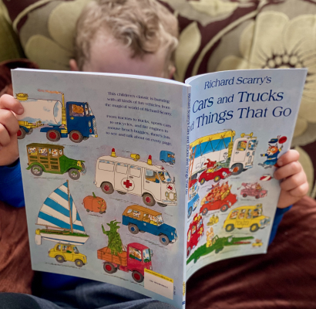
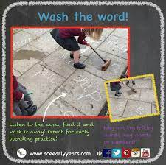
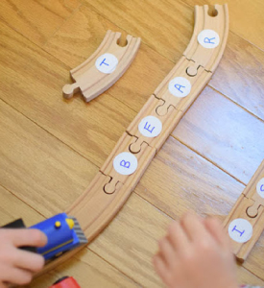
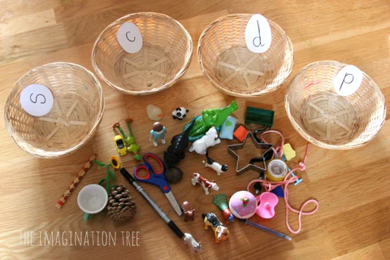
Creative ways to help reading at home

Slide 12
Reading a school book at home
When reading a school reading book at home with your child it is crucial that you promote independence in your child.
We will show you an example of this now...
Whether you are reading a book with words or a wordless book, all the fundamental reading skills can be developed. For example, ask your child to find something starting with a certain sound, point to the d...a...d, ask open questions etc.

Slide 13
What happens next?

