Slide 1

Developing writing throughout our time in Reception

Slide 2

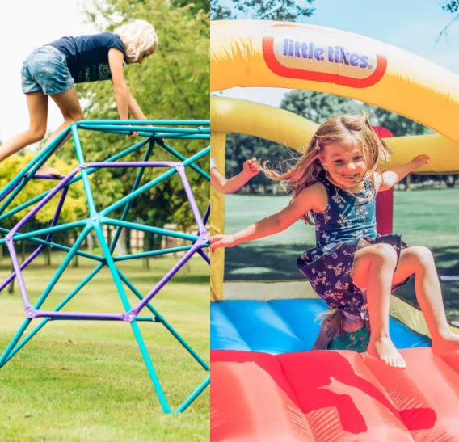
Physical Development is broken up into 2 strands – fine motor and gross motor.
Fine Motor - Fine motor skills involve small muscles working with the brain to control movements in areas such as hands, fingers and eyes.
Gross Motor - Gross motor skills are important to enable children to perform everyday functions like walking, running, climbing, throwing and catching…

Slide 3
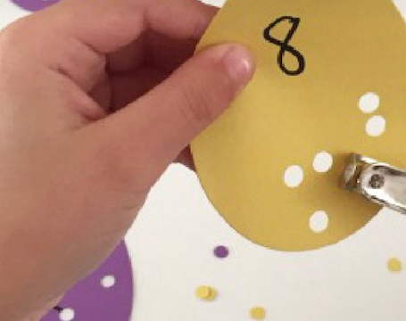
Fine motor Control
Fine motor control is a crucial skill throughout life.
We use fine motor skills in everyday life for basic things such as writing, using a computer and cooking!
If somebody has poor fine motor control they may struggle to do basic jobs.
Good fine motor control starts from birth (babies picking things up and passing from one hand to another).
It is now the perfect time to help your children develop their fine motor control!

Slide 4

What the Government says about Fine Motor
Fine Motor Skills ELG:
Children at the expected level of development will:
• Hold a pencil effectively in preparation for fluent writing – using the tripod grip in almost all cases;
• Use a range of small tools, including scissors, paint brushes and cutlery;
• Begin to show accuracy and care when drawing.

Slide 5
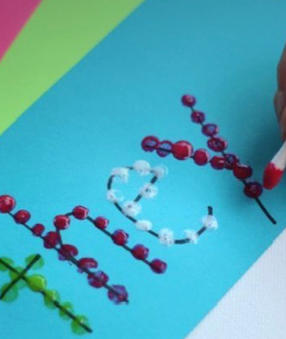
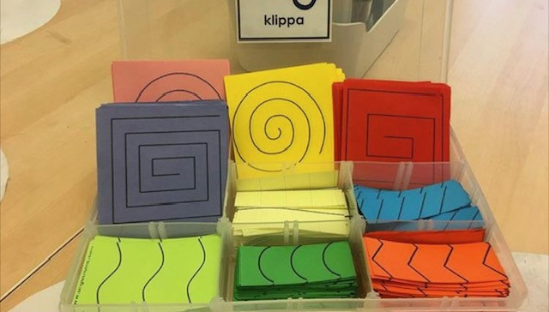
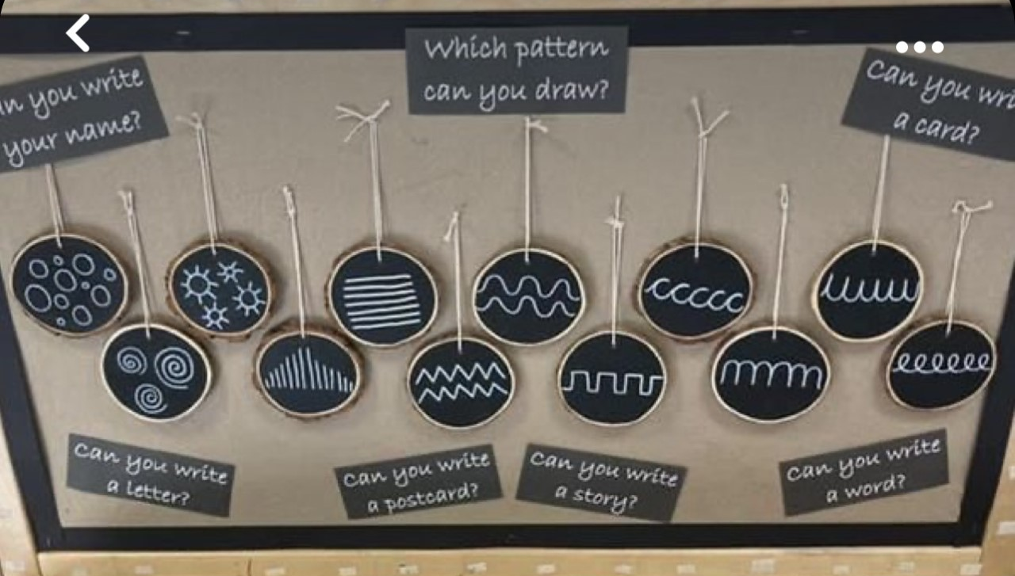
Fine motor development and writing
Fine motor control is the key indicator to how a child performs in writing. A child with good fine motor control will learn how to form letters correctly, draw with detail and have a good stamina for writing.

Slide 6
What the government says about Writing
ELG: Writing Children at the expected level of development will: - Write recognisable letters, most of which are correctly formed
- Spell words by identifying sounds in them and representing the sounds with a letter or letters
- Write simple phrases and sentences that can be read by others.

Slide 7
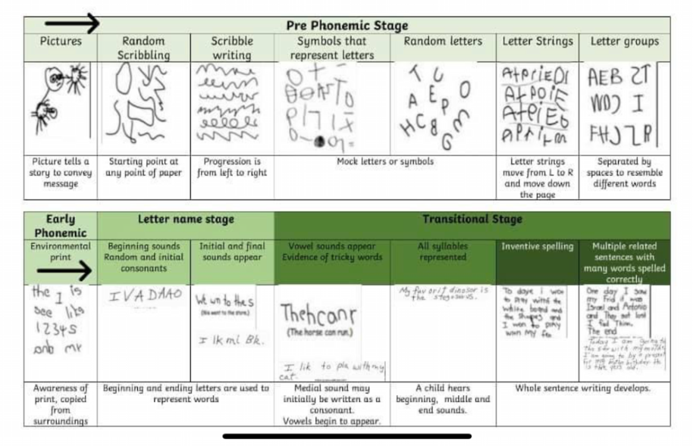

Slide 8
What writing looks like in school:
In school, we encourage children to write throughout all of the activities they do!
Children participate in weekly writing sessions where they work in a small group and complete a writing task. These are then kept in school and show progression.
Children write in phonics sessions where they practice newly taught sounds and recall previous learning.
Children do daily quick write where they practice letter formation and increase pace of writing.

Slide 9
What children find difficult about writing:
Fine motor skills
Phonics knowledge
Knowing how to write letters
Memory of what they are writing
Segmenting sounds in words
Confusion between letter names and sounds e.g. wait might be written as wAt.
Non decodable words
Chunking words up

Slide 10
Ways you can support this:
Encourage your child to segment words e.g. what sounds can you hear in 'door'?
Promote phonetical spelling at home as opposed to correct spelling e.g. bread = bred, sorry = soree.
Use letter sounds, not names.
Exposing children to both capitals and non-capital letters but explaining they still name the same sound.
Practice writing at home, encouraging children's interests.
Have regular stories and book sharing sessions.

