Slide 1

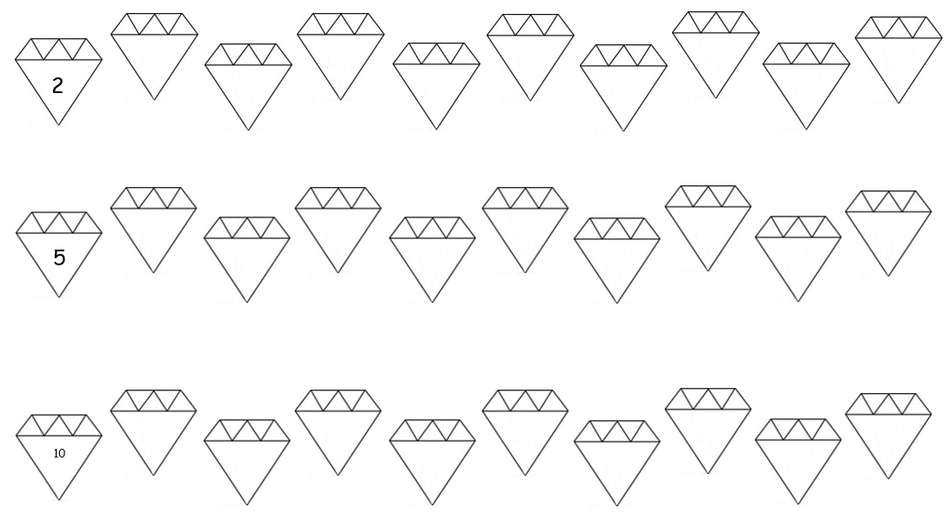
Diamond Dash
Pre Topaz

Slide 2
Diamond Dash
Topaz
1 x 2 =
2 x 2 =
3 x 2 =
4 x 2 =
5 x 2 =
6 x 2 =
7 x 2 =
8 x 2 =
9 x 2 =
10 x 2 =
11 x 2 =
12 x 2 =
1 x 5 =
2 x 5 =
3 x 5 =
4 x 5 =
5 x 5 =
6 x 5 =
7 x 5 =
8 x 5 =
9 x 5 =
10 x 5 =
11 x 5 =
12 x 5 =
1 x 10 =
2 x 10 =
3 x 10 =
4 x 10 =
5 x 10 =
6 x 10 =
7 x 10 =
8 x 10 =
9 x 10 =
10 x 10 =
11 x 10 =
12 x 10 =

Slide 3

Diamond Dash
Emerald
5 x 2 =
8 x 2 =
4 x 2 =
6 x 2 =
2 x 2 =
9 x 2 =
1 x 2 =
11 x 2 =
3 x 2 =
10 x 2 =
7 x 2 =
12 x 2 =
1 x 5 =
11 x 5 =
10 x 5 =
7 x 5 =
5 x 5 =
8 x 5 =
9 x 5 =
4 x 5 =
6 x 5 =
3 x 5 =
2 x 5 =
12 x 5 =
5 x 10 =
7 x 10 =
12 x 10 =
8 x 10 =
4 x 10 =
6 x 10 =
3 x 10 =
2 x 10 =
9 x 10 =
1 x 10 =
11 x 10 =
10 x 10 =

Slide 4

Diamond Dash
Pearl
6 x 2 =
10 x 2 =
7 x 2 =
3 x 2 =
2 x 2 =
9 x 2 =
1 x 2 =
11 x 2 =
5 x 2 =
8 x 2 =
4 x 2 =
12 x 2 =
5 x 5 =
1 x 5 =
11 x 5 =
4 x 5 =
8 x 5 =
9 x 5 =
7 x 5 =
6 x 5 =
3 x 5 =
2 x 5 =
10 x 5 =
12 x 5 =
4 x 10 =
6 x 10 =
3 x 10 =
2 x 10 =
5 x 10 =
8 x 10 =
9 x 10 =
1 x 10 =
11 x 10 =
10 x 10 =
7 x 10 =
12 x 10 =

Slide 5
Diamond Dash
Pearl
25 ÷ 5 =
30 ÷ 5 =
18 ÷ 2 =
24 ÷ 2 =
6 ÷ 2 =
20 ÷ 10 =
50 ÷ 5 =
35 ÷ 5 =
55 ÷ 5 =
14 ÷ 2 =
18 ÷ 2 =
90 ÷ 10 =
12 ÷ 2 =
30 ÷ 10 =
16 ÷ 2 =
45 ÷ 5 =
24 ÷ 2 =
80 ÷ 10 =
22 ÷ 2 =
45 ÷ 5 =

Slide 6

Diamond Dash
Ruby
1 x 2 =
11 x 2 =
10 x 2 =
7 x 2 =
12 x 2 =
5 x 2 =
8 x 2 =
4 x 2 =
6 x 2 =
3 x 2 =
2 x 2 =
9 x 2 =
5 x 5 =
2 x 5 =
4 x 5 =
9 x 5 =
10 x 5 =
7 x 5 =
1 x 5 =
12 x 5 =
6 x 5 =
8 x 5 =
3 x 5 =
11 x 5 =
10 x 3 =
2 x 3 =
5 x 3 =
9 x 3 =
4 x 3 =
11 x 3 =
8 x 3 =
6 x 3 =
12 x 3 =
1 x 3 =
7 x 3 =
3 x 3 =
5 x 4 =
8 x 4 =
1 x 4 =
11 x 4 =
10 x 4 =
4 x 4 =
6 x 4 =
3 x 4 =
2 x 4 =
9 x 4 =
7 x 4 =
12 x 4 =
5 x 8 =
10 x 8 =
7 x 8 =
12 x 8 =
8 x 8 =
4 x 8 =
6 x 8 =
3 x 8 =
2 x 8 =
9 x 8 =
1 x 8 =
11 x 8 =

Slide 7
Diamond Dash
Ruby
12 ÷ 3 =
64 ÷ 8 =
30 ÷ 3 =
32 ÷ 8 =
6 ÷ 2 =
20 ÷ 10 =
50 ÷ 5 =
35 ÷ 5 =
48 ÷ 4 =
14 ÷ 2 =
18 ÷ 2 =
90 ÷ 10 =
12 ÷ 2 =
18 ÷ 3 =
48 ÷ 4 =
45 ÷ 5 =
24 ÷ 2 =
80 ÷ 10 =
24 ÷ 8 =
45 ÷ 5 =

Slide 8
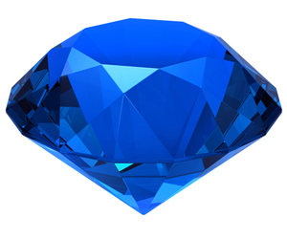
Diamond Dash
Sapphire
5 x 2 =
8 x 2 =
2 x 2 =
9 x 2 =
1 x 2 =
4 x 2 =
6 x 2 =
3 x 2 =
11 x 2 =
10 x 2 =
7 x 2 =
12 x 2 =
5 x 5 =
11 x 5 =
6 x 5 =
3 x 5 =
10 x 5 =
7 x 5 =
8 x 5 =
4 x 5 =
2 x 5 =
9 x 5 =
1 x 5 =
12 x 5 =
9 x 11 =
1 x 11 =
11 x 11 =
10 x 11 =
7 x 11=
12 x 11 =
5 x 11 =
8 x 11 =
4 x 11 =
6 x 11 =
3 x 11 =
2 x 11 =
3 x 3 =
2 x 3 =
10 x 3 =
7 x 3 =
12 x 3 =
9 x 3 =
1 x 3 =
11 x 3 =
5 x 3 =
8 x 3 =
4 x 3 =
6 x 3 =
5 x 4 =
8 x 4 =
9 x 4 =
1 x 4 =
11 x 4 =
2 x 4 =
10 x 4 =
7 x 4 =
12 x 4 =
4 x 4 =
6 x 4 =
3 x 4 =

Slide 9
Diamond Dash
Sapphire
5 x 6 =
10 x 6 =
7 x 6 =
8 x 6 =
4 x 6 =
9 x 6 =
1 x 6 =
11 x 6 =
6 x 6 =
3 x 6 =
2 x 6 =
12 x 6 =
10 x 7 =
7 x 7 =
6 x 7 =
3 x 7 =
2 x 7 =
9 x 7 =
1 x 7 =
5 x 7 =
8 x 7 =
4 x 7 =
11 x 7 =
12 x 7 =
2 x 8 =
9 x 8 =
1 x 8 =
5 x 8 =
8 x 8 =
3 x 8 =
11 x 8 =
10 x 8 =
7 x 8 =
4 x 8 =
6 x 8 =
12 x 8 =
12 ÷ 3 =
30 ÷ 5 =
56 ÷ 7 =
16 ÷ 4 =
64 ÷ 8 =
77 ÷ 11 =
50 ÷ 5 =
24 ÷ 8 =
30 ÷ 10 =
27 ÷ 9 =
18 ÷ 2 =
36 ÷ 6 =
20 ÷ 10 =
18 ÷ 3 =
88 ÷ 8 =
45 ÷ 5 =
24 ÷ 2 =
80 ÷ 10 =
121 ÷ 11 =
45 ÷ 5 =

Slide 10

Diamond Dash
Bronze
 | 11 | 4 | 6 | 3 | 10 | 5 | 8 | 7 | 9
7
4
9
11
1
5
12
8
2
10
3
6

Slide 11
Diamond Dash
Bronze
24 ÷ 3 =
25 ÷ 5 =
56 ÷ 7 =
72 ÷ 9 =
44 ÷ 11 =
70 ÷ 7 =
55 ÷ 11 =
64 ÷ 8 =
42 ÷ 6 =
36 ÷ 9 =
18 ÷ 2 =
36 ÷ 6 =
54 ÷ 9 =
108 ÷ 9 =
88 ÷ 8 =
66 ÷ 11 =
24 ÷ 2 =
132 ÷ 11 =
49 ÷ 7 =
24 ÷ 8 =
20 ÷ 10 =
81 ÷ 9 =
72 ÷ 6 =
45 ÷ 5 =
32 ÷ 8 =
63 ÷ 9 =
77 ÷ 7 =
40 ÷ 8 =
42 ÷ 6 =
60 ÷ 5 =

Slide 12
Diamond Dash
Silver
 | 2 | 4 | 6 | 12 | 10 | 5 | 8 | 7 | 9 | 11 | 3
7
4
9
11
1
5
12
8
x²
10
3
6

Slide 13
Diamond Dash
Silver
24 ÷ 3 =
√ 49 =
56 ÷ 7 =
12 ÷ 4 =
48 ÷ 8 =
70 ÷ 7 =
55 ÷ 11 =
64 ÷ 8 =
12 ÷ 4 =
√ 36 =
18 ÷ 2 =
36 ÷ 6 =
54 ÷ 9 =
108 ÷ 9 =
88 ÷ 8 =
√ 144 =
24 ÷ 2 =
80 ÷ 10 =
49 ÷ 7 =
24 ÷ 8 =
20 ÷ 10 =
9 ÷ 3 =
72 ÷ 6 =
8 ÷ 4 =
32 ÷ 8 =
63 ÷ 9 =
77 ÷ 7 =
18 ÷ 2 =
√ 16 =
60 ÷ 5 =
99 ÷ 11 =
144 ÷ 12 =
√ 121 =
84 ÷ 12 =
36 ÷ 12 =
44 ÷ 11 =
96 ÷ 12 =
60 ÷ 12 =
24 ÷ 12 =
48 ÷ 12 =

Slide 14
Diamond Dash
Gold Verbal
24 ÷ 3 =
√ 49 =
56 ÷ 7 =
12 ÷ 4 =
48 ÷ 8 =
70 ÷ 7 =
55 ÷ 11 =
64 ÷ 8 =
12 ÷ 4 =
√ 36 =
18 ÷ 2 =
36 ÷ 6 =
54 ÷ 9 =
108 ÷ 9 =
88 ÷ 8 =
√ 144 =
24 ÷ 2 =
80 ÷ 10 =
49 ÷ 7 =
24 ÷ 8 =

Slide 15

Diamond Dash
Quartz
5 x 13 =
8 x 13 =
2 x 13 =
9 x 13 =
1 x 13 =
4 x 13 =
6 x 13 =
3 x 13 =
11 x 13 =
10 x 13 =
7 x 13 =
12 x 13 =
5 x 14 =
11 x 14 =
6 x 14 =
3 x 14 =
10 x 14 =
7 x 14 =
8 x 14 =
4 x 14 =
2 x 14 =
9 x 14 =
1 x 14 =
12 x 14 =
9 x 15 =
1 x 15 =
11 x 15 =
10 x 15 =
7 x 15=
12 x 15 =
5 x 15 =
8 x 15 =
4 x 15 =
6 x 15 =
3 x 15 =
2 x 15 =
3 x 16 =
2 x 16 =
10 x 16 =
7 x 16 =
12 x 16 =
9 x 16 =
1 x 16 =
11 x 16 =
5 x 16 =
8 x 16 =
4 x 16 =
6 x 16 =
5 x 17 =
8 x 17 =
9 x 17 =
1 x 17 =
11 x 17 =
2 x 17 =
10 x 17 =
7 x 17 =
12 x 17 =
4 x 17 =
6 x 17 =
3 x 17 =

Slide 16
Diamond Dash
Quartz
5 x 18 =
10 x 18 =
7 x 18 =
8 x 18 =
4 x 18 =
9 x 18 =
1 x 18 =
11 x 18 =
6 x 18 =
3 x 18 =
2 x 18 =
12 x 18 =
10 x 19 =
7 x 19 =
6 x 19 =
3 x 19 =
2 x 19 =
9 x 19 =
1 x 19 =
5 x 19 =
8 x 19 =
4 x 19 =
11 x 19 =
12 x 19 =
2 x 80 =
9 x 80 =
1 x 80 =
5 x 80 =
8 x 80 =
3 x 80 =
11 x 80 =
10 x 80 =
7 x 80 =
4 x 80 =
6 x 80 =
12 x 80 =
65 ÷ 13 =
140 ÷ 20 =
84 ÷ 14 =
128 ÷ 16 =
32 ÷ 16 =
39 ÷ 13 =
85 ÷ 17 =
114 ÷ 19 =
54 ÷ 18 =
120 ÷ 15 =
104 ÷ 13 =
42 ÷ 14 =
76 ÷ 19 =
162 ÷ 18 =
51 ÷ 17 =
153 ÷ 17 =
91 ÷ 13 =
112 ÷ 14 =
135 ÷ 15 =
162 ÷ 18 =

Slide 17

Diamond Dash
Quartz Star
 | 20 | 13 | 16 | 15 | 14 | 80 | 19 | 17 | 18 | 7 | 40
9
4
7
11
2
5
12
8
3
10
1
6

Slide 18
Diamond Dash
Quartz Star
52 ÷ 4 =
45 ÷ 15 =
98 ÷ 14 =
105 ÷ 5 =
68 ÷ 4 =
90 ÷ 15 =
96 ÷ 6 =
136 ÷ 8 =
54 ÷ 3 =
57 ÷ 3 =
102 ÷ 17 =
90 ÷ 5 =
75 ÷ 15 =
240 ÷ 20 =
70 ÷ 14 =
153 ÷ 9 =
160 ÷ 20 =
98 ÷ 7 =
114 ÷ 6 =
34 ÷ 2 =
57 ÷ 19 =
209 ÷ 19 =
140 ÷ 10 =
42 ÷ 3 =
60 ÷ 4 =
112 ÷ 7 =
76 ÷ 4 =
152 ÷ 8 =
117 ÷ 13 =
160 ÷ 16 =
78 ÷ 13 =
180 ÷ 9 =
144 ÷ 9 =
143 ÷ 13 =
133 ÷ 7 =
135 ÷ 9 =
160 ÷ 16 =
120 ÷ 6 =
144 ÷ 8 =

Slide 19

Diamond Dash
Platinum
 | 20 | x³ | 6 | 12 | 16 | 25 | 8 | 0.5 | 9 | 11 | 13
9
4
7
11
2.5
5
12
8
x²
10
1.2
6

Slide 20
Diamond Dash
Platinum
252 ÷ 3 =
√ 169 =
112 ÷ 7 =
312 ÷ 4 =
312 ÷ 8 =
791 ÷ 7 =
85 ÷ 5 =
136 ÷ 8 =
1 ÷ 4 =
√ 3600 =
99 ÷ 11 =
276 ÷ 12 =
√ 121 =
186 ÷ 2 =
162 ÷ 6 =
5123 ÷ 1000 =
126 ÷ 9 =
824 ÷ 8 =
√ 144 =
24 ÷ 2 =
80 ÷ 100 =
49 ÷ 7 =
24 ÷ 8 =
84 ÷ 12 =
444 ÷ 12 =
462 ÷ 11 =
295 ÷ 5 =
975 ÷ 3 =
702 ÷ 6 =
8 ÷ 4 =
32 ÷ 8 =
630 ÷ 9 =
77 ÷ 7 =
18 ÷ 2 =
√ 16 =
635 ÷ 5 =
956 ÷ 100 =
60 ÷ 12 =
348 ÷ 12 =

