Slide 1



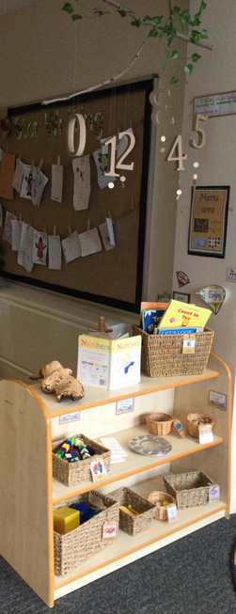
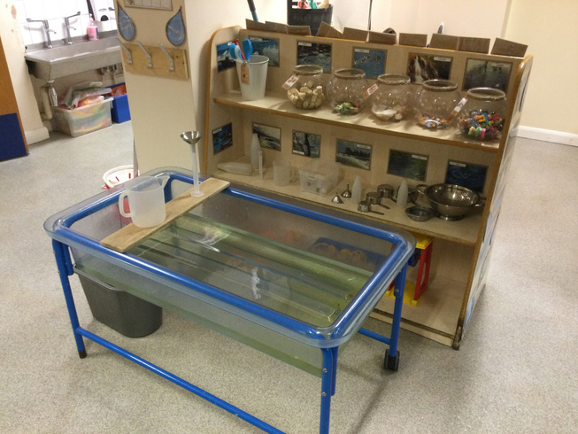
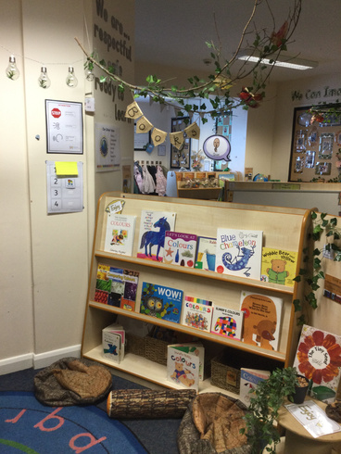
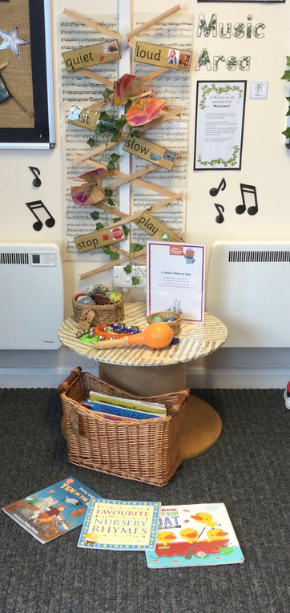
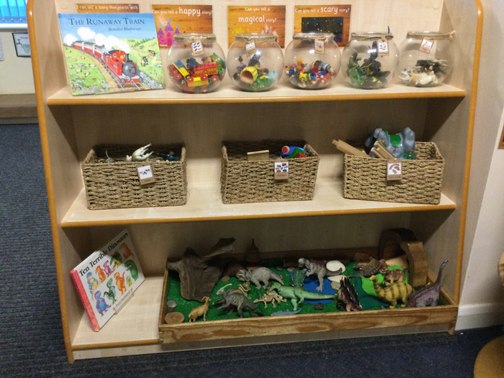
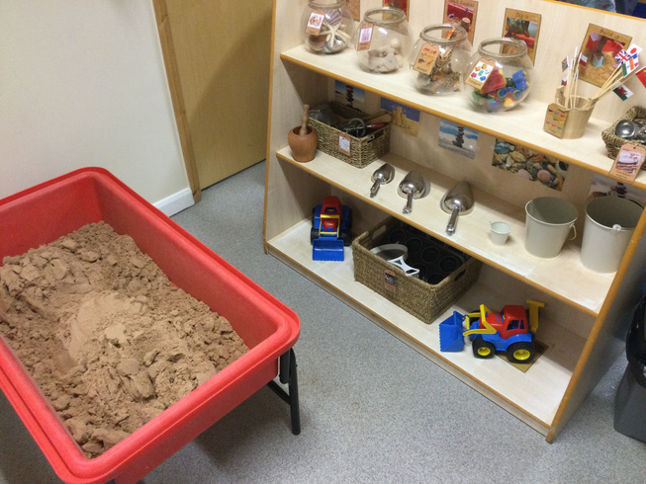

Pinders Primary School
Eastmoor Road
Wakefield
WF1 3SQ
01924 303700
Welcome to our Nursery
Nursery times
  Morning session: 8.40-11.40am
  Afternoon session: 12.15-3.15pm
  All day (30 hours) 8.40am-2.40pm
Option to pay a small charge to finish at 3.15pm
Staff
Mrs Diane Brown - Early Years Lead/Reception Teacher
Mrs Hannah Edwards - Nursery Teacher
Mrs Rebecca Taylor – Nursery Nurse

Slide 2














Curriculum
Nursery operates alongside our 45 place Reception class, with an extensive shared outdoor learning environment.
We follow the statutory framework for children aged 0 to 5 called the Early Years Foundation Stage. The curriculum is split into 7 areas of learning –
1.Communication & Language
2.Physical Development
3.Personal, Social & Emotional Development
4.Literacy
5.Mathematics
6.Understanding the World
7.Expressive Arts and Design
Our teaching and learning focuses on what children learn, and how they learn.
“Effective practice is a mix of different approaches. Children learn through play, by adults modelling, by observing each other and through adult-guided learning.”
(DFE, 2025)
Our setting presents children with a well resourced, organised learning environment which provides opportunities for both adult led and child led learning.
Outdoor learning
  We access our outdoor learning environment everyday.
  Please ensure your child is dressed appropriately for the weather.
  Please ensure your child is wearing safe suitable footwear.
  Provide a bag with spare clothing.

Slide 3













Nursery Information
Monday
Children receive free fruit and milk daily.
We do ask for 50p contributions to help us provide other snacks and carry out baking activities.
Tuesday - Library
You and your child choose a book to enjoy together at home, return your book the following week and choose a different one.
AM - 8.40am PM - 3.00pm
Friday - Star of the week
Every Friday a child receives a certificate and prize to celebrate individual achievements.
At the end of the half term we have a reading, writing, maths and physical star which are displayed in the classroom.
Clothing
  In nursery children can wear their own clothes or our school uniform.
  We ask that children wear clothes that are suitable to promote their independence. Clothes that they can fasten/unfasten when accessing the toilet.
  For safety reasons please do not send your child in jewellery.
  (Small studs are permitted in pierced ears.)
Please ensure you inform us if anyone different is going to be collecting your child, as we will only allow them to leave with people that you have given permission for and are listed on our admission form.

Slide 4








General Information
Whole school - One Life
We carry out daily one life routines and learning.
The framework explicitly teaches children how to manage their academic, personal, and social lives safely and happily.
Phonics - Little Wandle
In nursery we call this ‘Foundations for Phonics’ which focuses on oral blending and language development before introducing written letters. This is carried out daily.
Whole school - attendance
Children receive a sticker on their chart for every full week of school attended. Children can exchange their stickers for rewards of their choice from Mrs Bowen’s Attendance Emporium.
Whole school - ClassDojo
We have a school page and individual class pages to communicate with parents and carers. When your child starts nursery you will set up a login to access school information and updates on what your child is learning about.
School Absence
If your child is not going to be attending school please phone the school office on 01924 303700 to let us know what is wrong.
If your child suffers from sickness or diarrhoea they must be off school for at least 48 hours to ensure they have got rid of the bug completely.
Head Lice
Please check your child’s hair regularly for head lice and inform a member of staff if you have any unwelcome visitors!

Slide 5



Starting Nursery
After a home visit your child will be given a visit date to attend Nursery with a parent.
The visit will last one hour and is a chance for you to explore our classroom, meet the staff and other children joining nursery with your child.
If your child requires any further visits to support them settling in we will arrange this.
Visit day and time
Your child’s start date will be confirmed after forms and visits have been completed.

